Slide 1
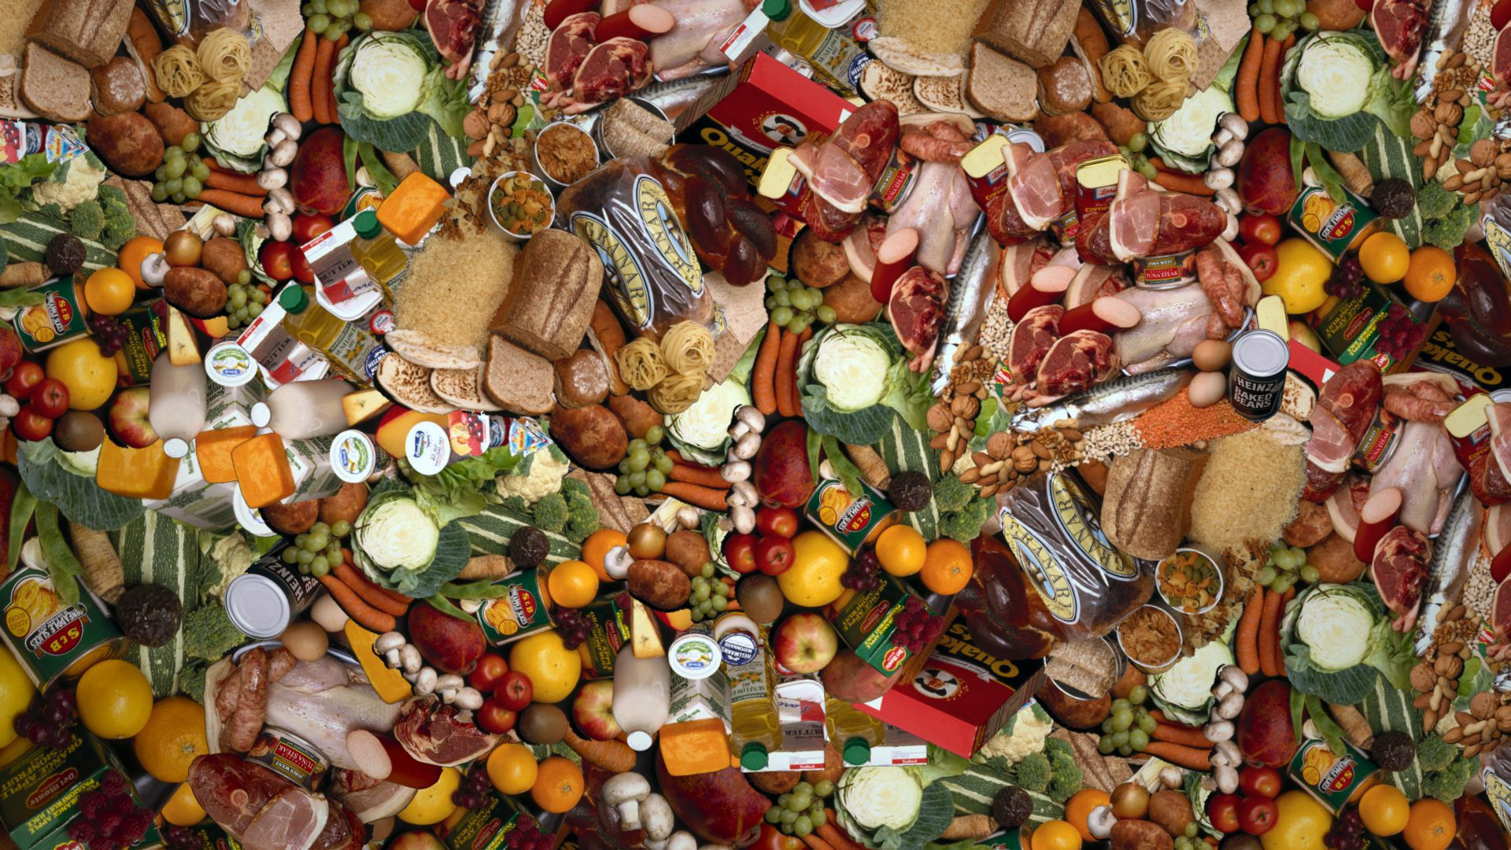

Challenge #1 by Team Foodie
Ai Hack @ Georgian College
March 30, 2019

Slide 2
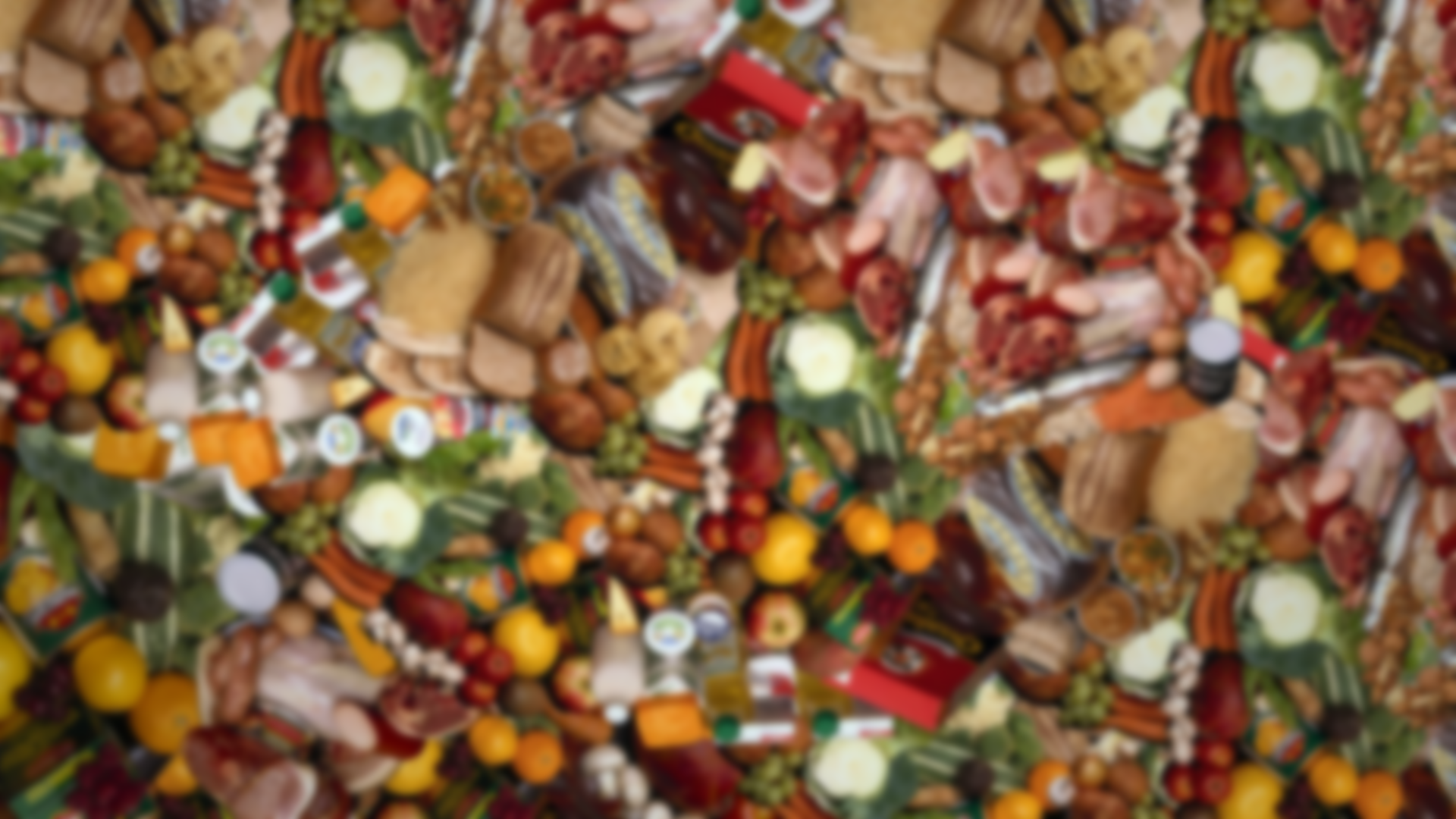
Problem
1.6 billion tonnes of food waste worth $1.2 trillion, goes to waste annually
Restaurants account for at least 160 million tonnes of food, that’s a $120 billion opportunity
Solution
Use A.I. to predict slow-moving inventory (i.e. foods) in real-time and connect them to buyers
Notes:
about one third of the food produced globally

Slide 3
3
Sales
Dinner
2
Lunch
1
80 – 90% of sales
Breakfast
Time

Slide 4
Sales
Dinner
Slow sales
Slow sales
Slow sales
Use real-time analytics to predict slow-moving inventory throughout the day, discount them, and push them into the slow sales zone
Lunch
Breakfast
Time

Slide 5
Sales
More core sales
More ancillary sales
Higher bottom-line
Higher retail traffic
Less waste
Social impact
Dinner
Transform slow-moving inventory into actual sales done through our platform
Lunch
Breakfast
Time

Slide 6
How? Through Foodie of course!

Slide 7
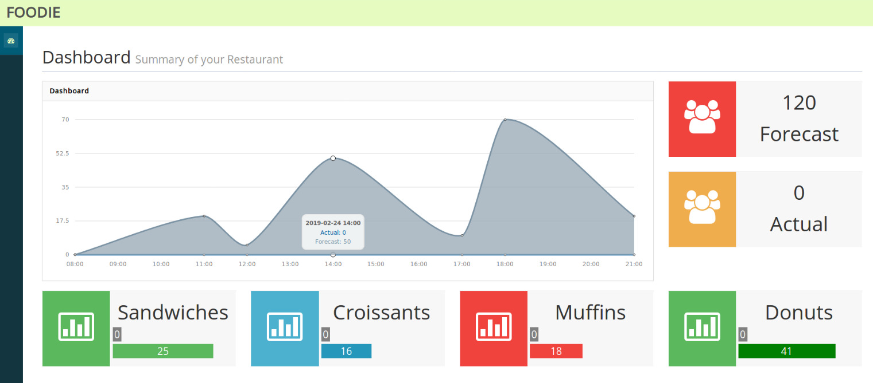
The Foodie Story
I arrive at the restaurant by 6am to prepare for our 7am open
Foodie will provide a forecast of sales today based on recent data available (e.g. weather, traffic, events, sales orders, app usage)

Slide 8
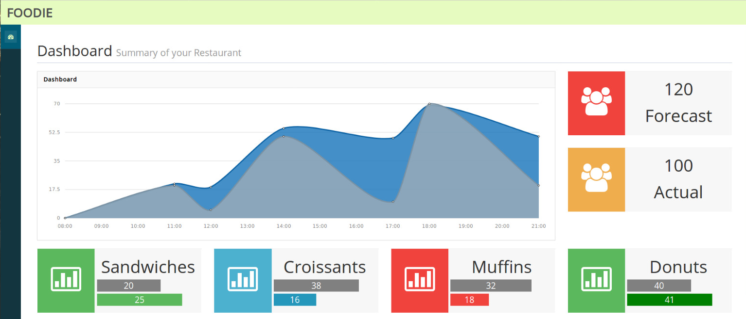
The Foodie Story
By 9:00am, Foodie will update the predicted actual sales using real time data
The restaurant owner will start prepping the slow-moving inventory to be sold at a discounted price through the app and picked up in-store (no added cost of delivery, etc.)

Slide 9
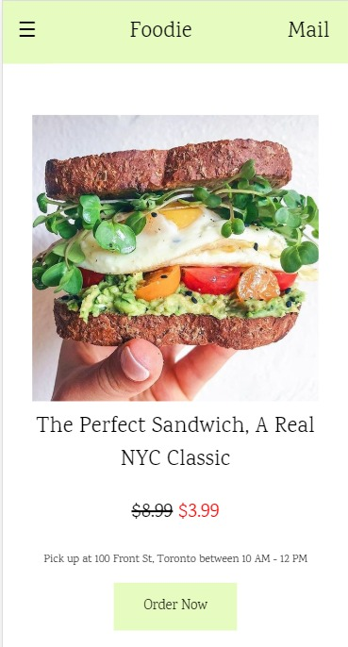
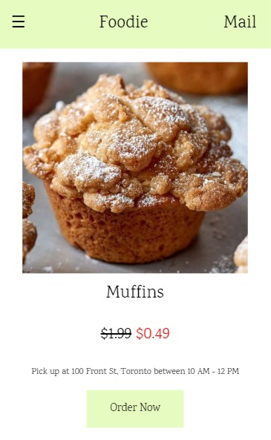


The Foodie Value
Business
More core sales
More ancillary sales
Higher bottom-line
Higher retail traffic
Lower labour costs
Social
Less food waste in landfills
Setting a good example for the world
How we make money?
Make a platform to connect seller to buyers.
We will make certain fee on each user transaction

Slide 10
Thank you!

Slide 11
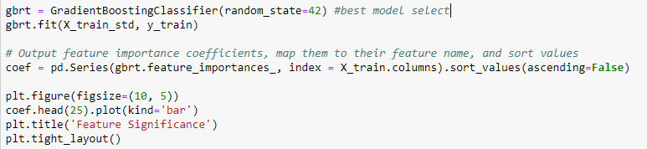
Model Algorithm Foodie will use Gradient Boosting model by using Ensemble learning. Ensemble learning is a way to learn different models in Machine Learning and use their predictions to predict better values than a single model. The Gradient Boosting provides additional models to compensate for errors in previous learned models. It learns a new model for the residual error in the pre-learning model.
Appendix

Slide 12
Financial
Appendix
This can boost your overall net profit by 21%
Without Foodie = $42,000
With Foodie = $51,000 ($9,000 extra)
Calculations
Food industry on average operates on thin-margins of 2 – 6% net profit
Assuming that 30% of food remains unsold:
For a restaurant having $1,000,000 worth of food / inventory
Assume that 70% will be sold:
$700,000 in sales will yield $42,000 in profits (6% x $700,000)
$300,000 in sales (slow-moving, discounted on Foodie) will yield an extra $9,000 (assuming 50% discount: 50% x $300,000 x 6% margin)

